Slide 1
Professional Issues in Computing Intellectual Property Rights
Dr. Aftab Maroof
NUCES, Islamabad Campus
(Lecture Slides Week # 9)
Notes:
Gaaey soap – bhains soap
Micro soft vs appl vs xerox in 1998 to 1992
Mirror image of apple, nike
Letter o and digit 0
Patent of privacy protecion by facebook
candy crush saga trademark – Candy Crush Saga – CANDY SLOTS
Lawsuit against samsung by apple, to target the h/w supporting android inspired from ios

Slide 2
Intellectual Property Rights
Confidential Information:
Information that a person receives in circumstances that make it clear they must not pass it on – obligation of confidence.
It is possible to take action in a civil court to prevent someone from using or revealing confidential information.
Common practice for obligation of confidence – specific clause / clauses in a contract. E.g. contracts for consultancy services, employees, stakeholders etc.
Non-disclosure agreements to protect exchanged information or obligation under equity.
Example:
Current sales prospects – Software Companies X vs. Y
Y may win if X’s sales staff pass on confidential information to Y
Common practice for contracts with employees having sensitive knowledge:
Longer notice period e.g. 6 months
Immediately remove from sensitive assignment and assign other tasks

Slide 3
Intellectual Property Rights
Confidential Information (Contd.):
Confidential information is not at all the same thing as professional skill and expertise.
An obligation of confidentiality is not absolute.
A court may rule that it is in the public interest that certain confidential information is disclosed. E.g. illegal price fixing, serious environmental damage.
This rules out an action for breach of confidence.
Conditions for an action on account of breach of confidential information:
The information must be confidential
The information must have been disclosed in circumstances which give rise to an obligation of confidence
There must be an actual or anticipated unauthorized use or disclosure of the confidential information

Slide 4
Intellectual Property Rights
Confidential Information (Contd.):
Qualifying disclosures:
A criminal offence
Failure to comply with a legal obligation
A miscarriage of justice
Danger to health and safety
Environmental damage
Information showing that any of these has been concealed
The law of confidence / obligation of confidence can usefully supplement copyright and patent laws.
Examples:
Idea for a new computer program / software
Secret algorithm
Lists of customers and contact details
Business methods
Contents of databases
A confidential information remains confidential until the matter falls into the public domain.

Slide 5
Intellectual Property Rights
Copyright:
Information age – key issue:
Knowledge Prospecting vs. Knowledge Piracy
IP Rights play a decisive role
As the name suggests, it is concerned with the right to copy something / work.
It may be a written document, a picture or photograph, a piece of music, a recording, or many other things including a computer program.
Copyright applies to any expressible form of an idea or information that is substantive and discrete and fixed in a medium.
Only certain types of work are protected by copyright law including original literary, dramatic, musical or artistic.
Literary work includes a table or compilation, a computer program, preparatory design material for a computer program etc.
Copyright grants exclusive rights to the creator of original scientific, artistic or literary works.
‘Original’ is key in defining a work that qualifies for copyright protection.

Slide 6
Intellectual Property Rights
Copyright:
Nature / Scope of Copyright
Intangible property
It prevents others from taking one’s work for free
It also prevents people from altering the work without permission
Personal expression of an idea, not the idea as such
Copyright Works
Literary works
Artistic works
Dramatic works
Musical works
Sound recordings and Broadcasts
Films and Cable Programs
Duration of Copyright
Life of author + 50 years
Registration:
Not required
Protection is automatic once work is created

Slide 7
Intellectual Property Rights
Copyright (Contd.):
What Does Copyright Give Rights Holders?
Right to reproduce the work
Right to prepare derivative works
Right to distribute copies for sale
Right to perform Audio Video works publicly
Right to display musical and artistic works publicly
Copyright Notice:
© owner, year of first publication, All rights reserved
Not compulsory
Intends to protect its copyright
Ownership:
Author – first owner
Employee’s work – employer as owner
Made in the course of employment
Commissioned work – ownership depends on contract
Exclusive license to use
Notes:
Copyleft

Slide 8
Intellectual Property Rights
Copyright (Contd.):
Restricted acts / Infringements
Copy
Not limited to hard copy
Include storage by electronic means - Fax, scan, hard disk storage, print, copy by hand
Issue to the public
Perform in public
Broadcast, include in a cable program service
Make an adaptation
Make available to the public through internet
Public domain
Anything in the public domain is useable by anyone in any way that they want. No one owns it.
Authors can choose to put work in the public domain by including a notice that the item is in the public domain.
When will copying constitute infringement?
Whole or substantial part
Quality and quantity
No prescribed %

Slide 9
Intellectual Property Rights
Copyright (Contd.):
Secondary Infringement:
Importing or exporting infringing copy
Possessing or dealing with infringing copy
Providing means for making infringing copies
Permitting use of premises for infringing performance
Provision of apparatus for infringing performance
How works protected?
Copyright ordinance / law / act
Criminal sanctions
Civil remedies

Slide 10
Intellectual Property Rights
Copyright (Contd.):
What is Fair Use?
Fair Use allows for copyrighted materials to be used without permission as long as certain guidelines are met:
The purpose and character of the use, including whether such use is of a commercial nature or is for nonprofit educational purposes;
The nature of the copyrighted work;
Fiction/non-fiction, published/unpublished work.
The amount and substantiality of the portion used in relation to the copyrighted work as a whole; and
The effect upon the potential market for or value of the copyrighted work.
Out of print vs. readily available, spontaneously chosen vs. assigned reading

Slide 11
Intellectual Property Rights
Copyright (Contd.):
What is Fair Use?
Fair use, realistically is basically limited to journalism, education, and research.
Limitations apply which includes consideration of the purpose, nature, amount and substantiality, and the effect of the use on potential value of work.
You can use excerpts from a book to write a review of it. However, you can’t reproduce whole chapters of the book for reviewing purposes without permission.
A class dealing with film studies can screen a movie without payment for study purposes. However, no admission can be charged and only students in the class can attend the screening.
Difficult area that can get people in trouble. Consult an attorney if you are in doubt…
Space Shifting
Time Shifting

Slide 12
Time Shifting

Slide 13
Space Shifting

Slide 14
Intellectual Property Rights
Copyright (Contd.):
Alternatives to Copyright:
Licenses
Creators can retain copyright but allow people to use content under certain terms. For example, the copyright can give schools to use content for free and without permission.
Open License
Others can use but must credit original source. Further, any version that others create must also have the open license and be useable by others as well.

Slide 15

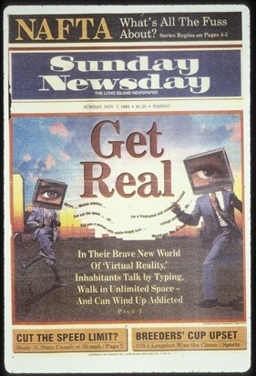

Intellectual Property Rights
Copyright (Contd.):
Unauthorized Use:

Slide 16
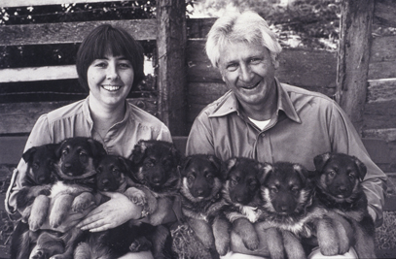
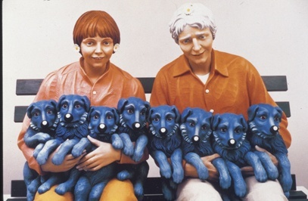
Intellectual Property Rights
Copyright (Contd.):
Change of medium is still infringement:

Slide 17
By permission of John Deering and Creators Syndicate, Inc.
Notes:
Performance rights, ASCAP, BMI, SESAC

Slide 18
Intellectual Property Rights
Copyright (Contd.):
Popular Copyright Myths:
If it’s on the internet it is in the public domain and therefore free
If there is no copyright notice, I can use the image
If I alter the image I don’t need permission
If I don’t profit from it, I can use it
If I only use a part of the image I don’t need permission

Slide 19
Intellectual Property Rights
Copyright (Contd.):
When in doubt, get permission
Where does a person start?
The copyright holder (usually the publisher) is the only one who can grant permission for use. Start with them.
It is advisable to put all requests in writing.
Be specific when you ask for permission to use copyrighted materials.
Name of publication, web page, photograph, video, etc…
What pages/portions of material you want to use.
What the usage is for.
What the duration of the usage is.
What citations the copyright holder wants used.
How many copies will be produced.

Slide 20
Intellectual Property Rights
Copyright (Contd.):
The Berne/TRIPS Framework on Copyright:
Berne Convention (BC) for the Protection of Literary and Artistic Works (1886)
Lays foundations of international copyright law
Establishes basic principles
Protect-able subject matter
Term of protection
Conditions of protection
Scope of protection
Rights under copyright
Limitations & exceptions

Slide 21
Intellectual Property Rights
Copyright (Contd.):
The Berne/TRIPS Framework on Copyright:
TRIPS Agreement (1994/95)
Makes BC mandatory for all WTO Members
Even those that are not Parties to the BC
Clarifies that computer programs & databases shall be protectable as literary works
Introduces rights to commercial rental after first sale
Makes copyright-related rights mandatory

Slide 22
Intellectual Property Rights
Copyright (Contd.):
Pakistan:
The Copyright Ordinance, 1962
The Copyright Rules, 1967
Procedure for Registration of Copyright
IPO – Copyright Introduction / FAQs

Slide 23
Intellectual Property Rights
Patents:
Patents relate to inventions and are primarily intended to encourage and protect new inventions, by giving inventors a monopoly on exploiting their inventions for a certain period.
A patent for an invention is grant of exclusive rights to make, use and sell the invention for a limited period of 20 years (Pak).
Jeff Bezos, CEO Amazon.com suggests it should be 3 to 5 years as software is
Less expensive, shorted life than other e.g. Pharmaceutical drugs.
A patent cannot be obtained on a mere idea or suggestion. Invention to be novel, useful and non-obvious.
Patent protection does not start until the actual grant of a patent.
Patent applications are examined for both technical and legal merit.
The TRIPS Agreement requires Member countries to make patents available for any inventions, whether products or processes, in all fields of technology without discrimination, subject to novelty, inventiveness and industrial applicability.

Slide 24
Intellectual Property Rights
Patents (Contd.):
A patent owner has the right to decide who may or may not use the patented invention for the period in which the invention is protected.
The patent owner may give permission to, or license, other parties to use the invention on mutually agreed terms.
The owner may also sell the right to the invention to someone else, who will then become the new owner of the patent.
Once a patent expires, the protection ends, and invention enters the public domain, that is, the owner no longer holds exclusive right to the invention, which becomes available to commercial exploitation by others.
Patent applications must be filed in each country to receive patent protection.

Slide 25
Intellectual Property Rights
Patents (Contd.):
Any person who makes an invention may deal with it in any of the following ways:
May broadcast the invention for free use by the public
Rare chance of mass-production scale manufacturing
May work the invention in secrecy without patenting it
Extremely difficult to work useful inventions in secrecy
May work the invention openly without patenting it
Same risks as those involved in secret-working, but sooner than secret-working
May exploit the invention on the basis of patents
Rights could be enforced legally
Secure commercial –scale manufacturing / Profitable use by selling or licensing

Slide 26
Intellectual Property Rights
Patents (Contd.):
Typical patent application includes:
Drawings
Brief abstract or summary
Patent specification
Detailed description of how to make or use the invention
Claims outlining boundaries of the claimed invention to prevent infringement
Patents are categorized / organized into classes / sub-classes
Patents may be assigned to more than one subclasses
Patent summary is published in the Official Gazette
Paris Convention and the Patent Cooperation Treaty provide reciprocal protection and filing rights in member countries
Conditions for patentable inventions in Pakistan:
The invention is new
It involves an inventive step
It is capable of industrial application
It should not be contrary to law or morality

Slide 27
Intellectual Property Rights
Patents (Contd.):
Un-Patentable Inventions in Pakistan
Discoveries of Laws of nature
Method of producing sound
Computer Programs (Software)
Method of writing music
The discovery of new properties of known substance
A system of alphabet, shorthand
Literary, dramatic, musical and artistic works
Mere charts, diagrams, or printed sheets
Purely scientific & mathematical formulae & principles

Slide 28
Software Patents
Data/Audio/Image/Video Compression
Mp3, gif,
Microsoft
IsNot operator, Page up/ page down/ Double Clicking
Progress bars
Pop up window in a web browser

Slide 29
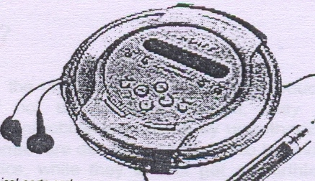
CD PLAYER
Intellectual Property Rights
Music played on the CD player is protected by copyright
Industrial design protection for 3D shape
Various technical parts & mechanisms are subject mater of protection under Patents
Brand name- registered under trademark

Slide 30
Intellectual Property Rights
Trademarks:
Trademarks relate to product names or symbols.
Either a word, name, phrase, color, symbol or design, or combination of words, phrases, symbols, or designs that identifies and distinguishes the source of the goods or services of one party.
Trademarks identify the product of a particular manufacturer or supplier. E.g. Microsoft, McDonalds, Oracle, Coca Cola etc.
Trademark protects any word, name, logo or device used to identify, distinguish or indicate the source of goods or services.
Appears on the product or on its packaging (TM - trademark).
The purpose is to safeguard the integrity of products and to prevent product confusion and unfair competition.
Protects trademark owner’s interest in brand name value and good will
Protects consumers from confusion
Trademarks are renewable indefinitely as long as the mark is being used.

Slide 31
Intellectual Property Rights
Trademarks (Contd.):
Registering Trademark: First to File vs. First to Use
Select registration in countries in which the company will manufacture, distribute and/or license its mark.
The owner of a trademark must protect the mark in different countries under that countries’ relevant laws.
Under International Agreements, an applicant from one country may file a trademark application based on an application or registration in another country.
Trademark filing / registration has four purposes:
To retain control over the quality and types of use of the marks
To provide a basis for challenging infringers
To prevent third parties from registering a company’s marks
To minimize the financial risk

Slide 32
Intellectual Property Rights
Trademarks (Contd.):
Selecting the right trademark:
The strongest type – an invented word such as “XEROX”
The weakest type – descriptive such as “QUALITY SOFTWARES”
Register the appropriate form of the trademark - Composite marks:
Register the entire composite mark
Register the word portion of a mark alone
Register the design element
Trademark symbols:
® - Registered trademark / service mark symbol
™ – Unregistered trademark symbol
SM – Unregistered service mark symbol
Don’t use the registration symbol (®) in countries where the mark has not been registered to avoid civil and criminal penalties.

Slide 33
Intellectual Property Rights
Trademarks (Contd.):
Trademarks legislation in Pakistan:
Trademarks Act 1940
Revised Rules 1963
Trademarks Ordinance 2001
Trademarks Rules 2004
Registration Validity (Pak):
Initially for Ten (10) years from the filing date
Renewal after every Ten (10) years

Slide 34
Trade Marks vs. Service Marks
Service mark is a word, phrase, symbol or logo that is used to brand, identify, and distinguish a service, in contrast to a trademark, which is used for a product.
Example: McDonalds for restaurant services, WalMart for retails store services.
Example: Tiffany & Co for jewelry products, Nike for a line of footwear and clothing products.
If FedEx has a slogan: Faster than a lightening bolt – brand its shipping and delivery services. If moves on to sell selling boxes and packaging materials, it becomes a product mark.

Slide 35
Intellectual Property Rights
Domain Names:
Internet Corporation for Assigned Names and Numbers (ICANN)
Internationally organized, non-profit making corporation
Domain Name System (DNS)
Universal resolvability – always lead to the same location
Originally for connecting computers, now for identifying businesses
Companies want to use trademarks as domain names
Trademark – Domain Name Conflict:
Trademarks:
Territorial registration and application / regional basis
Different classes
Examination and opposition
Goods and services in commerce
Domain Names:
First come first served
One unique registration
Application across jurisdictions
In principle, no examination
Broad use

Slide 36
Intellectual Property Rights
Domain Names (Contd.):
Cyber Squatting:
Registering trademarks of other companies as your own domain names
Then sell domain name to the owner of trademark at an inflated price
Possible because of inconsistencies in trademark and domain name registration systems
WIPO published a report in 1999 titled “The management of Internet names and addresses: Intellectual property issues”.
Recommended ICANN to adopt a policy called the Uniform Domain Name Dispute Resolution Policy (UNDRP) which includes specific provisions against cyber squatting.
In 2001, WIPO published a 2nd report “The recognition of rights and the use of names in the Internet domain system”.
Addresses conflicts between domain names and identifiers other than trademarks
E.g. use of personal or peoples names that have no connection with them.

Slide 37
Intellectual Property Rights
Registered Designs:
Protects the artistic aspect (namely, texture, pattern, shape) of an object instead of the technical features.
The term of protection.
The third party is prohibited from making, selling or importing articles bearing a design which is a copy of the protected design, when such acts are undertaken for commercial purposes.
Legislation (Pak):
Design Ordinance 2000
Registered Layout-Designs of Integrated Circuits Ordinance, 2000

Slide 38
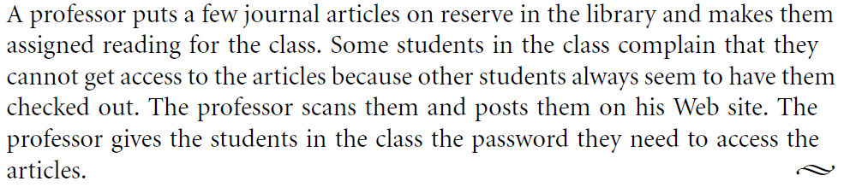

Slide 40
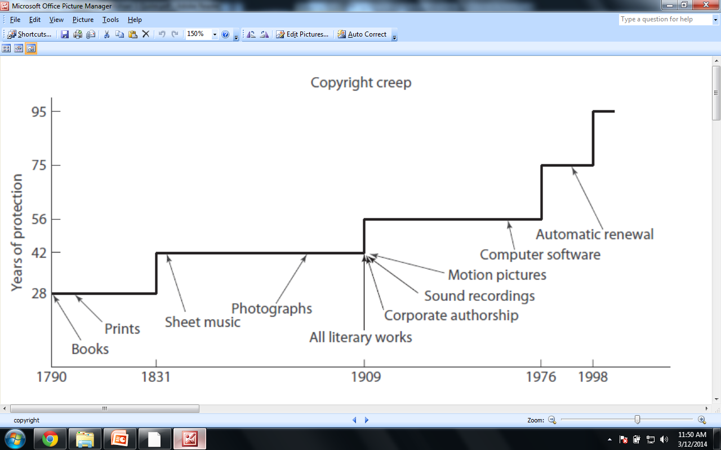

Slide 41
Geographical Indications
Geographical indication has been defined as "an indication which identifies such goods as agricultural goods, natural goods or manufactured goods as originating, or manufactured in the territory of a country, or a region or locality in that territory, where a given quality, reputation or other characteristic of such goods is essentially attributable to its geographical origin and in case where such goods are manufactured goods one of the activities of either the production or of processing or preparation of the goods concerned takes place in such territory, region or locality, as the case may be.“
Protected by Article 22 and 23 of the TRIPS agreement
Purpose the public is not misled and prevention of use of a geographical name which although literally true "falsely represents" that the product comes from somewhere else

Slide 42


Darjeeling tea, Lahori Fish, Afghani Pulao, Kasuri Methi, Nagpur Orange
Shiraz carpets (persian)
, “FLORIDA” (for oranges) – The Florida Sunshine Tree
“WASHINGTON STATE” (for apples)
Basmati Rice
Mexican Tequila

